Slide 1
Business Problem
“ To Extract the final Amount from any Invoice bill. ”
By : SMIT DOSHI

Slide 2
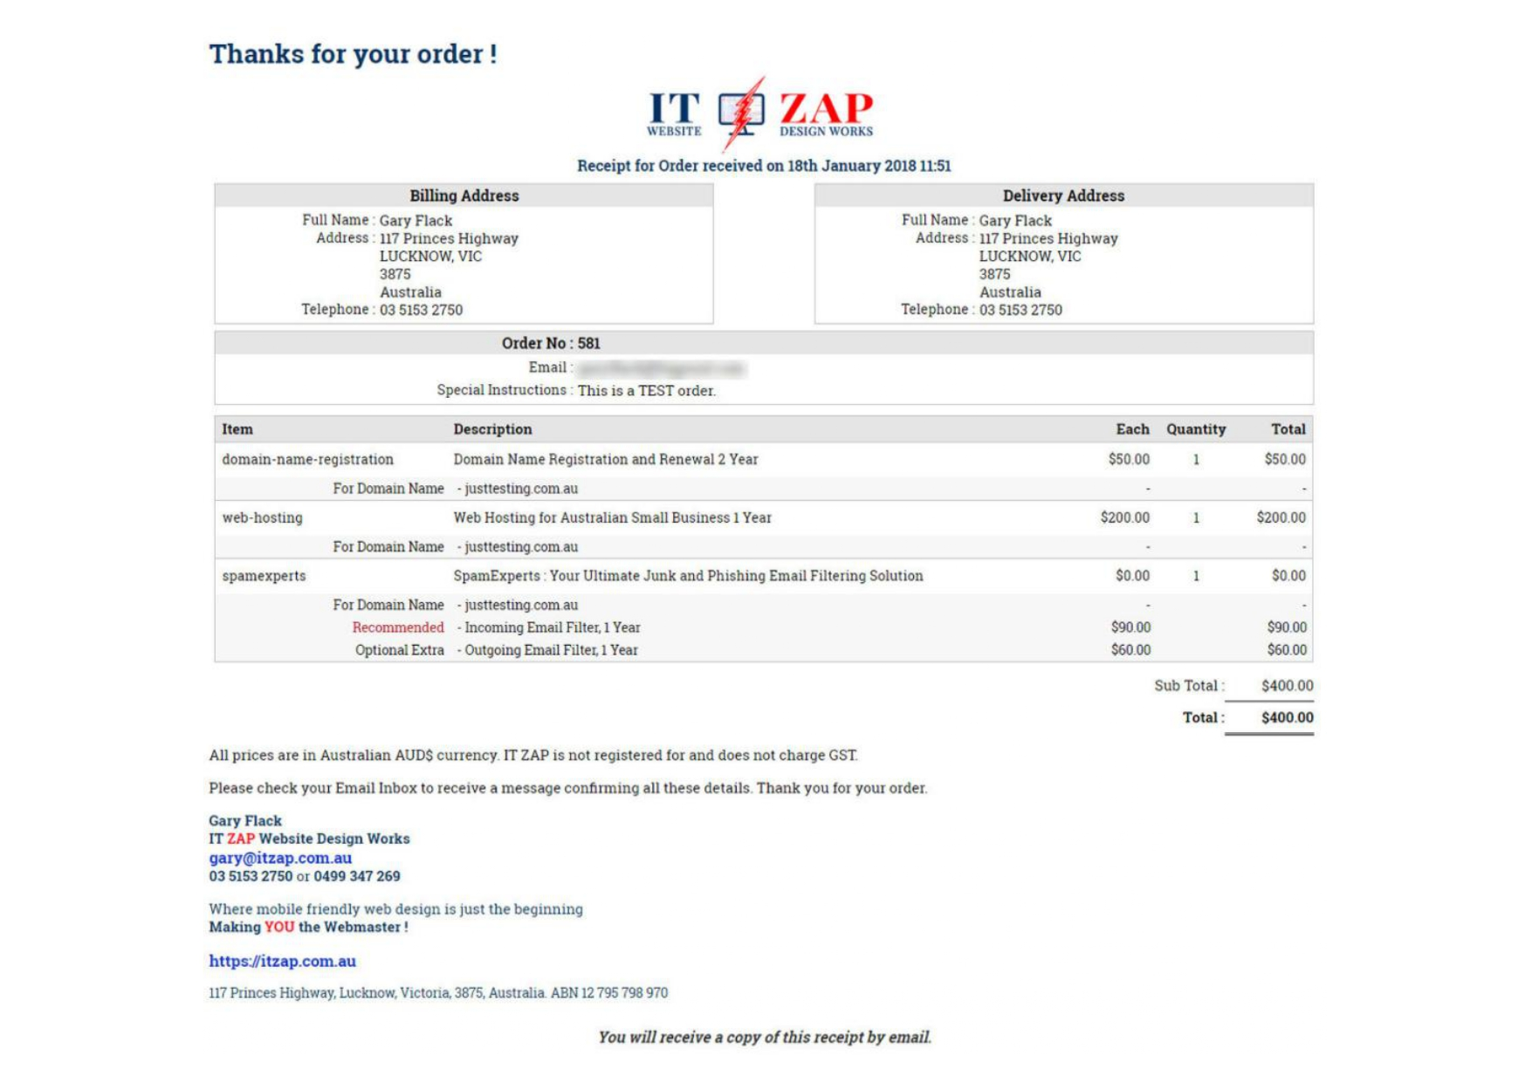

Slide 3

Project analysis slide 3
Process Analysis
INPUT
CONVERT
REASON
Max( ) Function
RESULT
Must be a form of a Pdf
Convert the input pdf into .jpg /.jpeg /.png format
Simplest way to extract text in the form of a string
Use the max function on the floating number instead of Integer
The final solution must print 400.00 $

Slide 4
Thank You

